Slide 1
COMPUTER NETWORK AND COMMUNICATION Course code: CS3001-1

Slide 2
Course Learning objectives
Outline the principles of computer networks and its application.
Understand the basic of physical and data link layer functionalities and protocols .
Study the importance of network layer and differentiate various routing algorithms .
Analyze the process of QoS and congestion control algorithms.
Acquire the knowledge of working of transport layer, its protocols and some application layer protocols.

Slide 3
Syllabus
UNIT-I 15 Hours
Introduction: Data Communications, Networks, Network Types, Connection-Oriented Versus Connectionless Service, Introduction to network Devices-Modem, Hub, Switch, Router, Network Models: TCP/IP Protocol Suite, OSI Model, OSI versus TCP/IP.
Physical Layer: Introduction to Physical Layer: Digital Signals, Transmission Impairment, Data Rate Limits, Performance, Example Problems(self-learning), Line Coding Schemes (Unipolar and Polar only)
Transmission Media: Guided Media, Switching: Introduction, Packet Switching.
Data-Link Layer: Introduction, Link-Layer Addressing (up to ARP) Error Detection and Correction Introduction, Block Coding, Cyclic Redundancy Check,
Media Access Control: CSMA, CSMA/CD. (Textbook T1)

Slide 4
UNIT-II 16 Hours
Data Link Layer Contd.
Wired LANs: Ethernet Protocol, Standard Ethernet (up to Access Method), Wireless LANs: Introduction (Textbook T1)
Network Layer: Network-Layer Services, Packet Switching, Network Layer Performance. IPv4 Addresses, Packet Format of IPv4, IPv6 Address and packet format, ICMPv4 (Textbook T1)
Routing Algorithms up to Multicast Routing, Congestion Control Algorithms, Quality of Service, Internetworking. (Textbook T2)
Routing for Mobile Hosts (self-learning)
UNIT-III 9 hours
Transport Layer: Transport Layer Services, Port Numbers, User Datagram Protocol, Transmission Control Protocol
Application Layer: Introduction, Client/Server Paradigm, Standard Client-Server Protocols: World Wide Web and HTTP, FTP, Electronic Mail, DNS, (Textbook T1)
Telnet and SSH (self-learning)

Slide 5
Suggested List of Experiments Part-A(Experiments using NS-2/ NS-3)
Simulate a three nodes’ point-to-point network with duplex links between them. Set the queue size, vary the bandwidth and find the number of packets dropped.
Simulate a four-node point-to-point network, and connect the links as follows: n0-n2, n1-n2 and n2-n3. Apply TCP agent between n0-n3 and UDP n1-n3. Apply relevant applications over TCP and UDP agents changing the parameter and determine the number of packets by TCP/UDP.
Simulate the different types of Internet traffic such as FTP a TELNET over a network and analyze the throughput.
Simulate the transmission of ping messages over a network topology consisting of 6 nodes and find the number of packets dropped due to congestion.
Simulate an Ethernet LAN using N-nodes (6-10), change error rate and data rate and compare the throughput.
Simulate an Ethernet LAN using N nodes and set multiple traffic nodes and determine collision across different nodes.
Simulate an Ethernet LAN using N nodes and set multiple traffic nodes and plot congestion window for different source/destination.

Slide 6
PART B (Experiments using C/C++/Python)
Write a program for error detecting code using CRC-CCITT (16-bits).
Write a program for frame sorting technique used in buffers.
Write a program for distance vector algorithm to find suitable path for transmission.
Using TCP/IP sockets, write a client-server program to make client sending the filename and the server to send back the contents of the requested file if present.
Using UDP SOCKETS, write a client-server program to make the client sending two numbers and an operator, and server responding with the result. Display the result and appropriate messages for invalid inputs at the client side.
Write a program for Hamming Code generation for error detection and correction.
Write a program for simple RSA algorithm to encrypt and decrypt the data.

Slide 7
Course Outcomes:
Develop a foundation in data communications and networking principles, enabling them to understand and apply networking concepts.
Understand the working of data link layer, the protocols and differentiate the types of LAN.
Demonstrate a comprehensive understanding of network layer services and addressing schemes.
Distinguish between various routing and congestion control algorithms and understand the Quality of Service required for various networking applications.
Portray the transport layer protocols and understand the working of various application layer protocols.

Slide 8
TEXTBOOKS:
Behrouz A Forouzan, Data and Communications and Networking, Fifth Edition, McGraw Hill, Indian Edition.
Ch 1: 1.1, 1.2, 1.3-1.3.1,1.3.2, Ch 2: 2.2, 2.3, Ch 3: 3.3, 3.4, 3.5, 3.6, Ch 4: 4.1.2, Ch 7: 7.2, Ch 8: 8.1, 8.3, Ch 9: 9.1, 9.2-9.2.1, 9.2.2, Ch 10: 10.1, 10.2, 10.3.1, Ch 12: 12.1.2, 12.1.3, Ch 13: 13.1, 13.2-13.2.1,13.2.2, 13.2.3, Ch 15: 15.1, Ch 18: 18.1, 18.2, 18.3, 18.4, Ch 19: 19.1-19.1.1,19.1.2, 19.2, Ch 22: 22.1-22.1.1, 22.1.2, 22.1.3, 22.2,Ch 23: 23.1.1, Ch 24: 24.1.2, 24.2, 24.3-24.3.1 to 24.3.6, Ch 25: 25.1, 25.2, Ch 26: 26.1, 26.2, 26.3, 26.4, 26.5, 26.6
Computer Networks, Andrew S. Tanenbaum David J. Wetherall, 5th Edition, Pearson, ISBN 10: 1292024224, 2014
Ch 1: 1.3.3, Ch 5: 5.2-5.2.1 to 5.2.8, 5.3, 5.4-5.4.1 to 5.4.4
REFERENCE BOOKS:
Computer Networking. A Top-down Approach, James F. Kurose, Keith W. Ross, Pearson, ISBN: 1292153598, 2017
Data and Computer Communications, 10th Edition, William Stallings, Pearson Education, 2013, ISBN: 0133506487,9780133506488
Larry L Peterson and Brusce S Davie, Computer Networks, fifth edition, ELSEVIER

Slide 9
Data communications are the exchange of data between two devices via some form of transmission medium such as a wire cable.
INTRODUCTION: DATA COMMUNICATIONS
Characteristics of Data communications
Delivery.
Accuracy.
Timeliness.
Jitter.

Slide 10
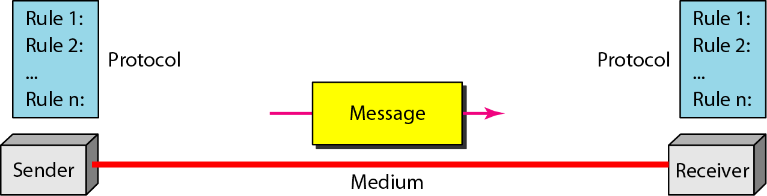
Components of a data communication system
Message
Sender
Receiver
Transmission medium
Protocol

Slide 11
Data Representation
Information today comes in different forms such as text, numbers, images, audio, and video.
Numbers
bit patterns
binary numbers
Text
ASCII, Unicode
Images
Audio → Samples of continuous signal
Video → Sequence of bitmap images
11

Slide 12
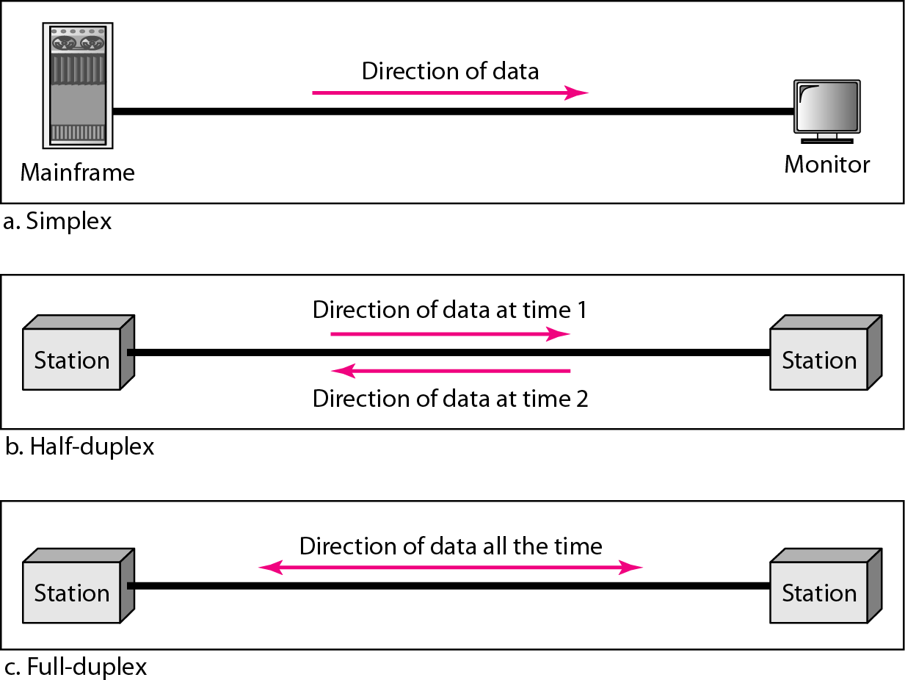
Data flow (simplex, half-duplex, and full-duplex)
12

Slide 13
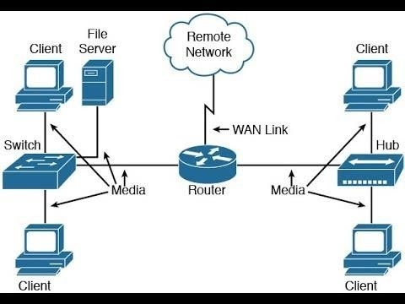
NETWORKS
A network is the interconnection of a set of devices capable of communication.

Slide 14
Computer Network
A computer network is a system that connects two or more computing devices for transmitting and sharing information.
Computing devices include everything from a mobile phone to a server.
These devices are connected using physical wires such as fiber optics, but they can also be wireless.

Slide 15
NETWORKS
Network Criteria
Performance
Transit time
Response time
Throughput
Delay
Reliability:
Accuracy of delivery
Frequency of failure
Time a link takes to recover from failure
Robustness in a catastrophe
Security
Protecting data from unauthorised access
Protecting data from damage and development.
Implementing policies and procedures for recovery from breaches and losses.

Slide 16
Physical structures of Networks
Types of Connections
Network is two or more devices connected through links. There are two types of connections
Point-to-point
Multipoint (multidrop)

Slide 17
Point-To-Point Connection
Link
Provides dedicated link between two devices

Slide 18

Multipoint Connection
Link
More than two specific devices share a single link

Slide 19
Physical Topology
The term physical topology refers to the way in which a network is laid out physically.
Two or more device connect to a link
The topology of a network is the geometric representation of the relationship of all the links and linking devices to one another.
There are four basic topologies.
Mesh
Star
Bus
Ring

Slide 20
Mesh Topology
E
A
D
B
C
In mesh topology every device has a dedicated point to point link to every other device
We need n(n-1) links
Communication is duplex mode
Every device on the network must have n-1 i/o ports to connect to the other n-1 devices.

Slide 21
Mesh Topology
In mesh topology every device has a dedicated point to point link to every other device
We need n(n-1) links
Communication is duplex mode
Every device on the network must have n-1 i/o ports to connect to the other n-1 devices.

Slide 22
Mesh Topology
Pros:
Dedicated links
Robustness
Privacy
Easy to identify fault
Cons:
A lot of cabling
I/O ports
Difficult to move
17

Slide 23
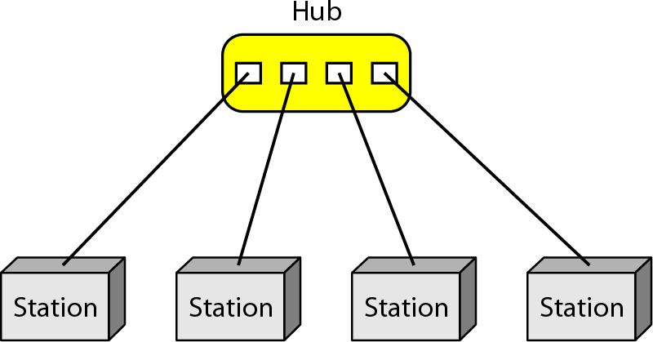
Star Topology
A
D
Hub
B
C

Slide 24
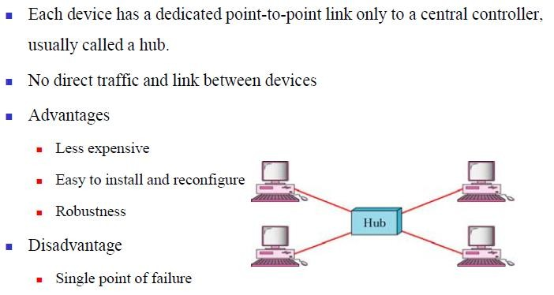
Star Topology
A
D
B
C
More cabling is required than other topologies

Slide 25
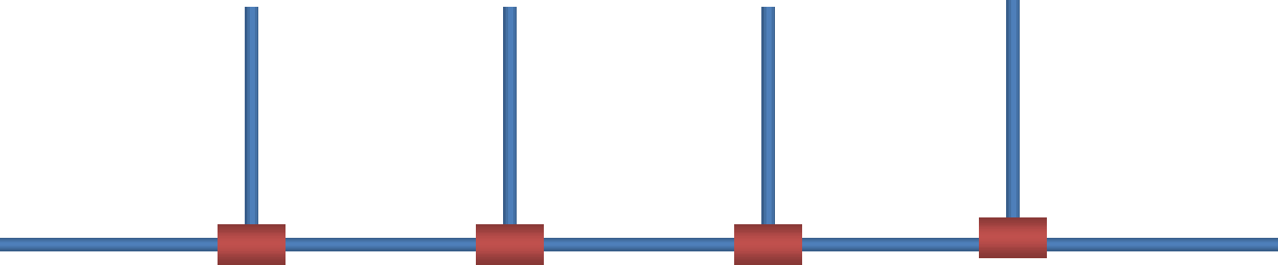
Bus Topology
Drop line
Tap
Tap
Tap
Tap
Cable End
Cable End
20

Slide 26
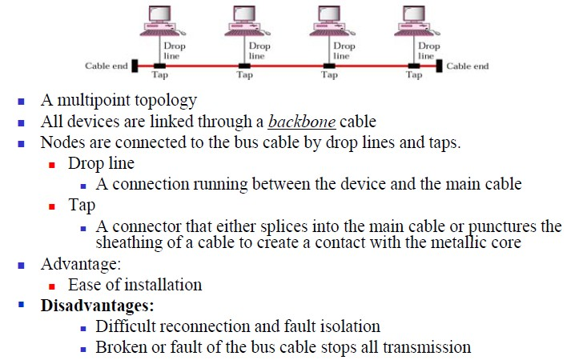
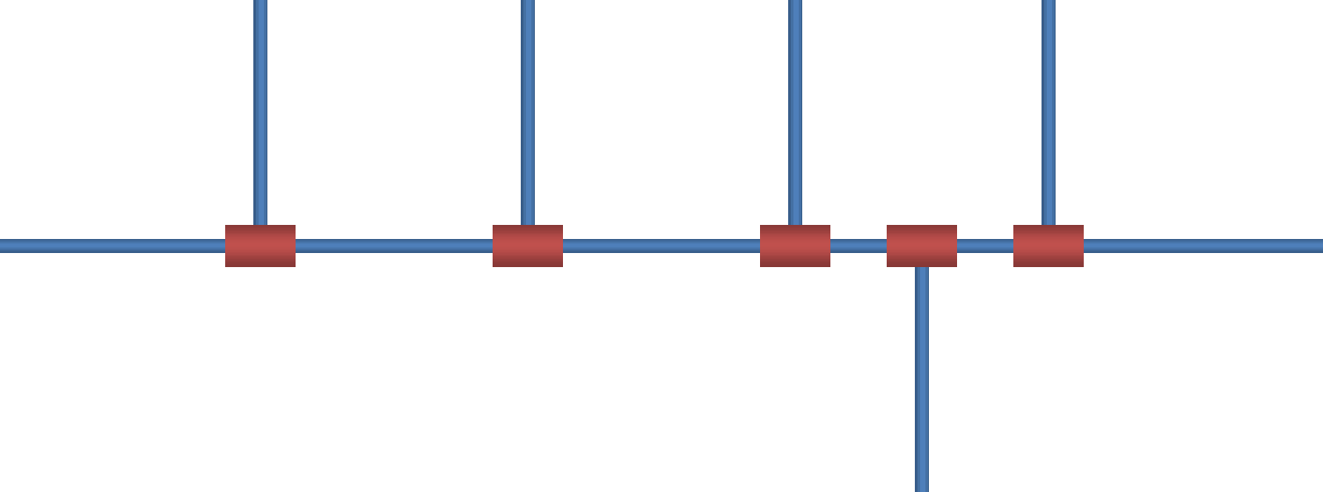
Bus Topology

Slide 27
Ring Topology
C
D
B
Repeater
Repeater
Repeater
Repeater
A

Slide 28
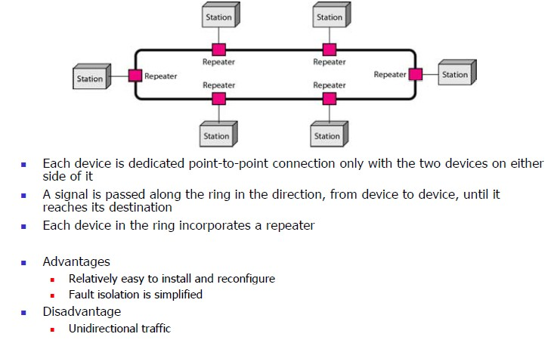
Ring Topology
Pros:
Easy to install
Easy to identify fault
Cons:
Delay in large ring
Break in the ring stops all transmission

Slide 29
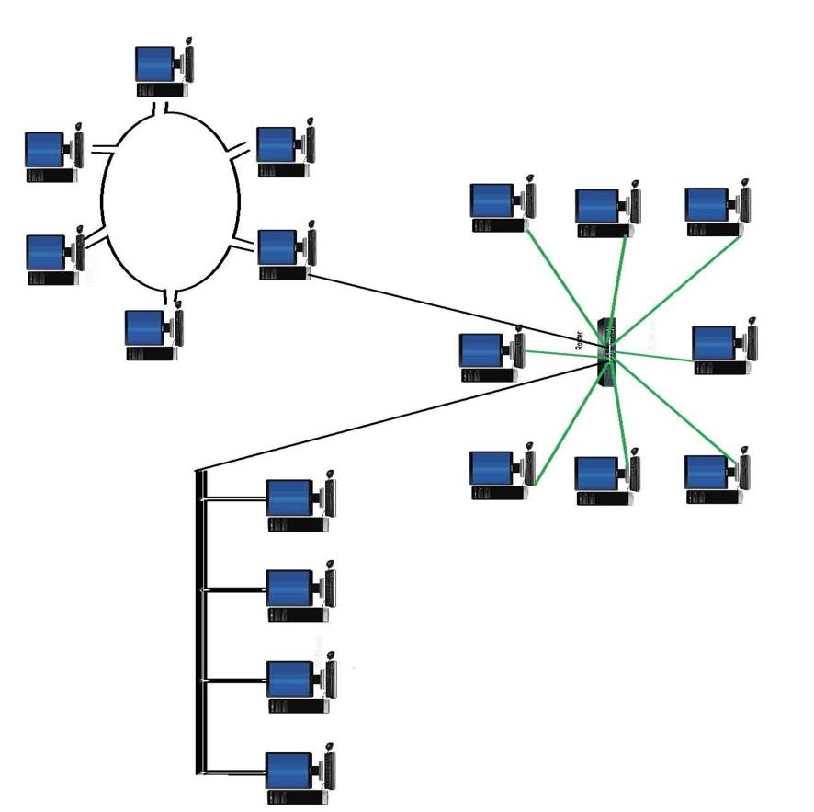

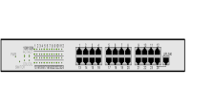
Hybrid Topologies
24

Slide 30
Network Types
The criteria used for distinguishing the network type
Size
Geographical coverage
Ownership
Network types
Local Area Network (LAN)
Wide Area Network (WAN)
Metropolitan Area Network (MAN)

Slide 31
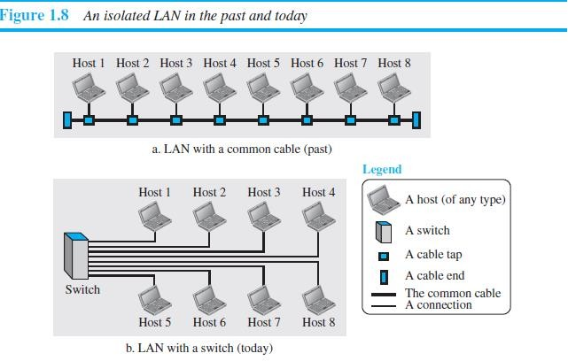
Local Area Networks
It is a privately owned network in a single office, building, or campus.
Each host in the LAN has an address.
A packet carries source host address and destination host address

Slide 32
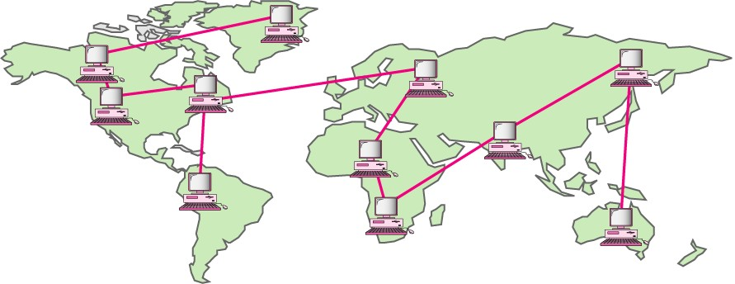

Wide Area Networks
Has wider geographical coverage
Spanning a town, a state, a country or even the world.
WAN interconnects connecting devices.

Slide 33
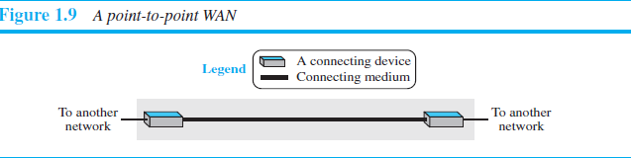
Two distinct examples of WAN:
Point-to-point WANs
Switched WANs
Point-to-point WANs
Two communicating devices are connected

Slide 34
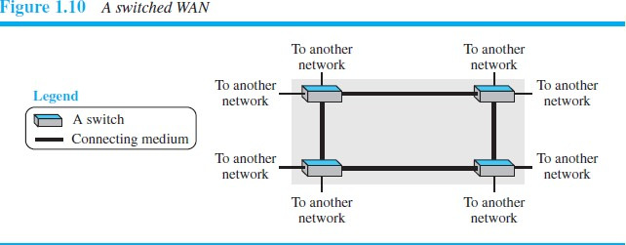
Switched WANs
Network with more than two ends
WAN is combination of several point-to-pont WANs connected by switches

Slide 35
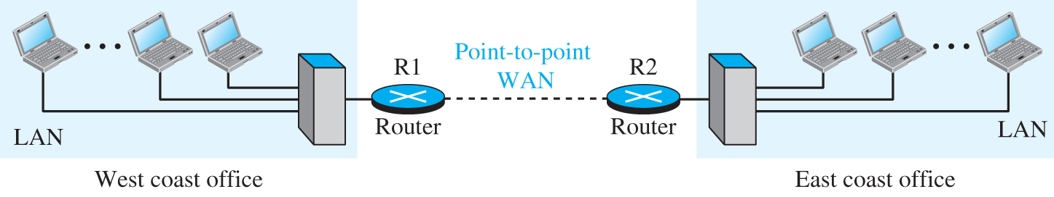
Examples

Slide 36
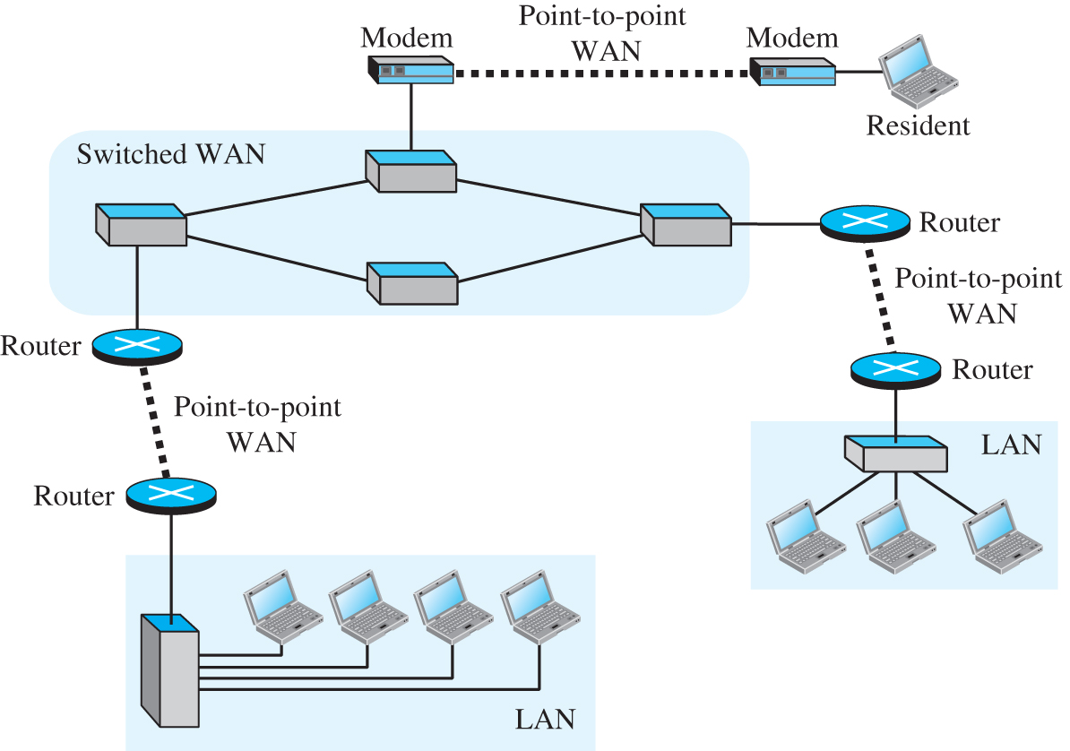

Slide 37
The Internet
An internet (note the lowercase i) is two or more networks that can communicate with each other.
The most notable internet is called the Internet (uppercase I) and is composed of millions of interconnected networks.

Slide 38
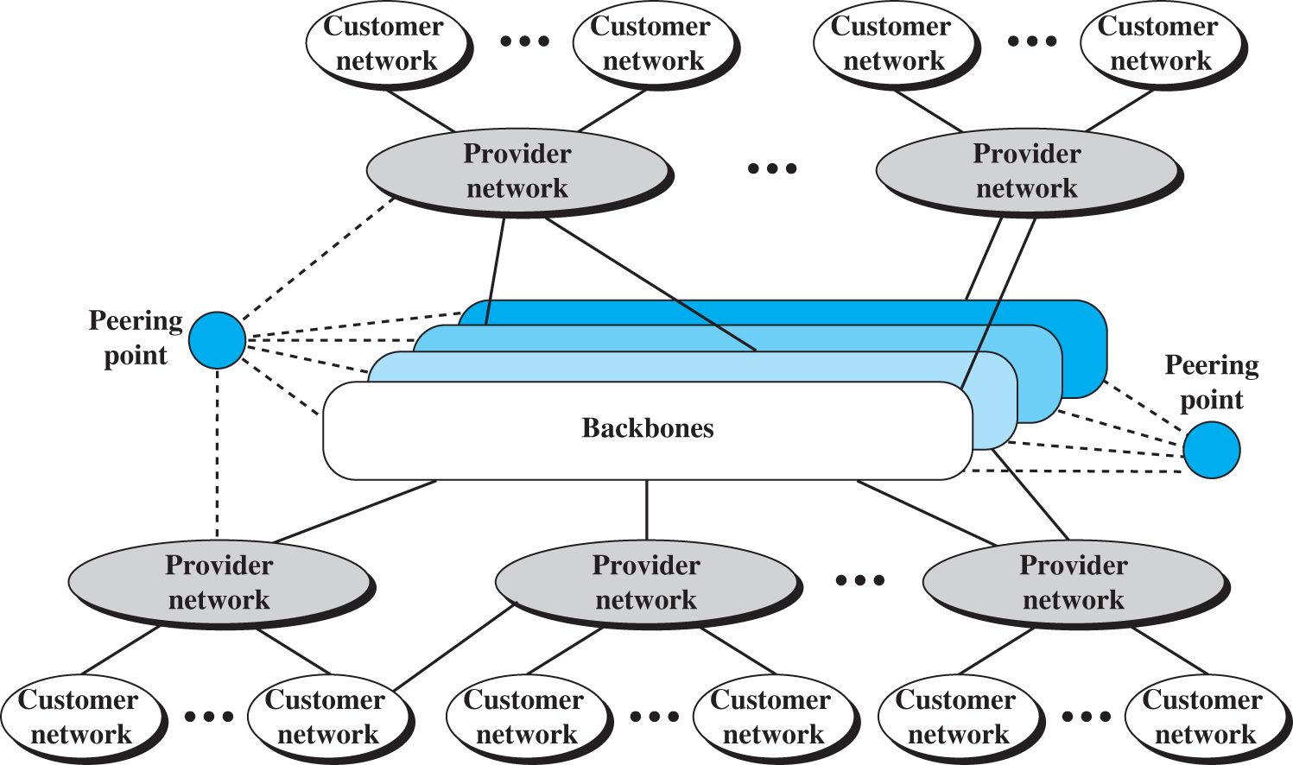
Figure 1.13 The Internet today A network topology representing the internet shows several backbones connected to several provider networks and peering points. The peering points connect to the provider networks. The provider networks connect to multiple customer networks. The provider networks establish connections between them. Similarly, the customer networks have connections between them.

Slide 39
Accessing the Internet
Using Telephone Networks
Dial-up Service
DSL Service
Using Cable Networks
Using Wireless Networks
Direct Connection to the Internet

Slide 40
Connection-Oriented Versus Connectionless Service
Layers can offer two different types of service to the layers above them: connection- oriented and connectionless.
In this section we will look at these two types and examine the differences between them.
Connection-oriented service is modeled after the telephone system.
To talk to someone, you pick up the phone, dial the number, talk, and then hang up. Similarly, to use a connection-oriented network service, the service user first establishes a connection, uses the connection, and then releases the connection.

Slide 41
Connection-Oriented Versus Connectionless Service
In some cases when a connection is established, the sender, receiver, and subnet conduct a negotiation about the parameters to be used, such as maximum message size, quality of service required, and other issues.
Typically, one side makes a proposal and the other side can accept it, reject it, or make a counterproposal.
A circuit is another name for a connection with associated resources, such as a fixed bandwidth.
This dates from the telephone network in which a circuit was a path over copper wire that carried a phone conversation.

Slide 42
Connection-Oriented Versus Connectionless Service
In contrast to connection-oriented service, connectionless service is modeled after the postal system.
Each message (letter) carries the full destination address, and each one is routed through the intermediate nodes inside the system independent of all the subsequent messages.
Each kind of service can further be characterized by its reliability.
Some services are reliable in the sense that they never lose data. Usually, a reliable service is implemented by having the receiver acknowledge the receipt of each message so the sender is sure that it arrived.
The acknowledgement process introduces overhead and delays, which are often worth it but are sometimes undesirable.

Slide 43
Connection-Oriented Versus Connectionless Service
A typical situation in which a reliable connection-oriented service is appropriate is file transfer. The owner of the file wants to be sure that all the bits arrive correctly and in the same order they were sent.
Very few file transfer customers would prefer a service that occasionally scrambles or loses a few bits, even if it is much faster.
Reliable connection-oriented service has two minor variations:
In message sequences variant, the message boundaries are preserved. When two 1024-byte messages are sent, they arrive as two distinct 1024-byte messages, never as one 2048-byte message.
In byte streams. , the connection is simply a stream of bytes, with no message boundaries. When 2048 bytes arrive at the receiver, there is no way to tell if they were sent as one 2048-byte message, two 1024-byte messages, or 2048 1-byte messages.
Example :
If the pages of a book are sent over a network to a phototypesetter as separate messages, it might be important to preserve the message boundaries.
On the other hand, to download a DVD movie, a byte stream from the server to the user’s computer is all that is needed. Message boundaries within the movie are not relevant.

Slide 44
Connection-Oriented Versus Connectionless Service
Not all applications require connections.
For example, spammers send electronic junk-mail to many recipients. The spammer probably does not want to go to the trouble of setting up and later tearing down a connection to a recipient just to send them one item.
Nor is 100 percent reliable delivery essential, especially if it costs more. All that is needed is a way to send a single message that has a high probability of arrival, but no guarantee.
Unreliable (meaning not acknowledged) connectionless service is often called datagram service, in analogy with telegram service, which also does not return an acknowledgement to the sender.

Slide 45
Connection-Oriented Versus Connectionless Service
For some applications, the transit delays introduced by acknowledgements are unacceptable. One such application is digitized voice traffic for voice over IP.
It is less disruptive for telephone users to hear a bit of noise on the line from time to time than to experience a delay waiting for acknowledgements.
In other situations, the convenience of not having to establish a connection to send one message is desired, but reliability is essential.
The acknowledged datagram service can be provided for these applications.
Still another service is the request-reply service. In this service the sender transmits a single datagram containing a request; the reply contains the answer.
Request-reply is commonly used to implement communication in the client-server model: the client issues a request and the server responds to it.
For example, a mobile phone client might send a query to a map server to retrieve the map data for the current location.

Slide 46
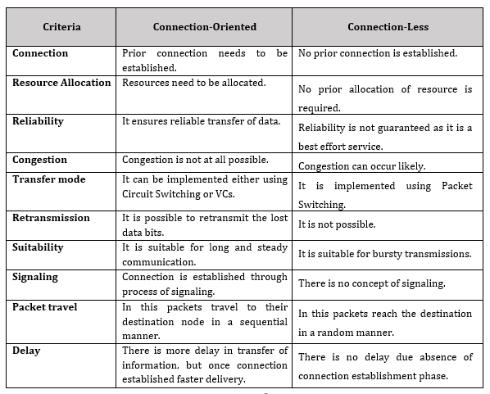
Connection-Oriented Versus Connectionless Service

Slide 47
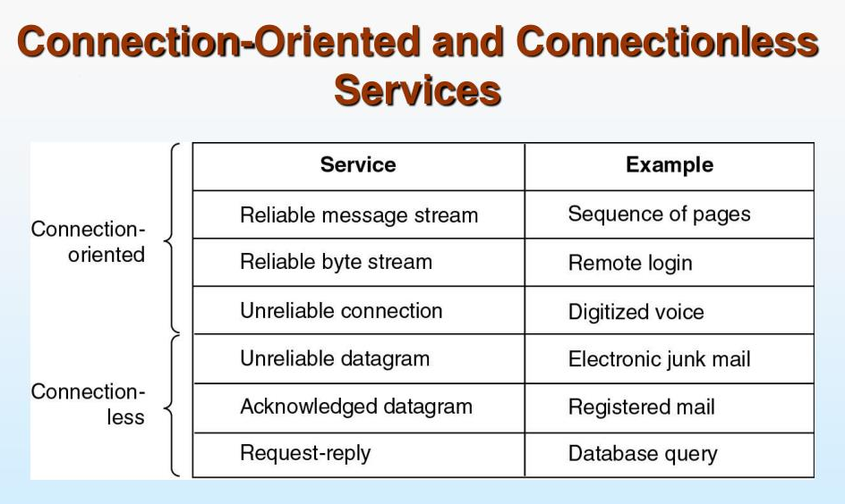
Summary of the types of services discussed

Slide 48
Introduction to network Devices
Network Devices: Network devices, also known as networking hardware, are physical devices that allow hardware on a computer network to communicate and interact with one another.
For example
Repeater, Hub, Bridge, Switch, Routers, Gateway, Brouter, and NIC, etc

Slide 49
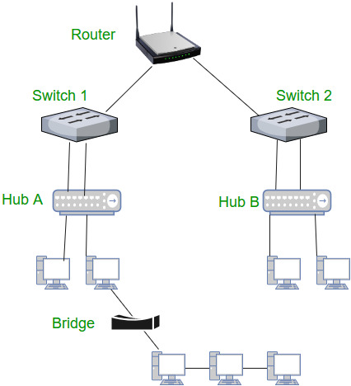

Slide 50
Modem
The main purpose of a modem is to modulate and demodulate -- or convert -- signals between devices, such as analog to digital.
Nowadays, the most common type of modem is an internet modem
Which facilitates internet access by receiving signals from an ISP and converting them into a format that connected devices can use, such as radio or digital signals.

Slide 51
Modem
A modem typically connects to a router, which receives internet access from the modem and sends it to other devices on the network.
Modems can use Ethernet cable, DSL, fiber or wireless mediums for connectivity.
ISPs frequently provide modems that have combined routing and firewalling capabilities.
Depending on the type, a modem operates at Layer 1 or Layer 2 of the OSI model.

Slide 52
Hub
A hub is a physical device used to join multiple devices on the same LAN.
For example, a laptop, desktop computer and printer can connect into a hub's ports with Ethernet cables and be part of the same local network.
Unlike a bridge, router or switch, a hub broadcasts messages it receives from one port to all remaining ports without examining the frames or isolating the message for the intended destination
A hub must connect to a router or switch in order to communicate outside its LAN.

Slide 53
Switch
A network switch forwards data to its destination by examining an incoming frame's MAC address and sending it to the device with the matching address.
Devices connect into a switch's ports usually via an Ethernet cable.
The switch stores those devices' MAC addresses in an address table it uses as a reference when transferring frames.
While a router forwards data to an IP address or network, a switch sends the information directly to the specific destination port

Slide 54
Router
A router directs data requests from one network to another.
Routers examine incoming packets to determine the appropriate destination IP address and then forward the packet to that destination.
A router can also enable internet access through its connection to a modem, or as a combined modem-router.
As with a bridge, routers maintain and use routing tables that contain route information, such as IP addresses and interfaces.
Once a router inspects a packet, it refers to the routing table to find the best path toward the destination.
Routers use routing protocols to communicate and exchange data.

Slide 55
Router
Types of routers typically used in enterprise networks include the following:
edge routers
core routers
distribution routers
wireless routers

Slide 56


Slide 57
Network Models
THE OSI (Open System Interconnection) MODEL
Established in 1947, the ISO (International Organization for Standard) is a multinational body dedicated to worldwide agreement on international standards.
An ISO standard that covers all aspects of network communications is the OSI model.
It was first introduced in the late 1970s.
Open System refers to a set protocols that allows two computers to communicate regardless of underlying architecture.
OSI is not a protocol; but it is a model for understanding and design of a network architecture that is robust , flexible and interoperable.

Slide 58
The OSI model
The OSI model is a layered framework for the design of network systems that allows communication between all types of computer systems.
It consists of seven separate but related layers, each of which defines a part of the process of moving information across a network

Slide 59




Slide 60
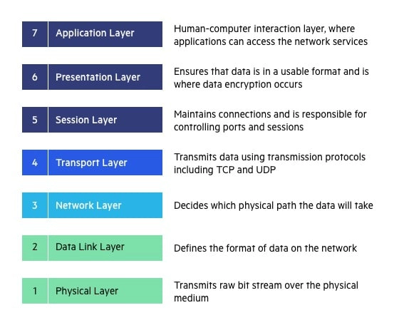
The OSI 7 Layers

Slide 61
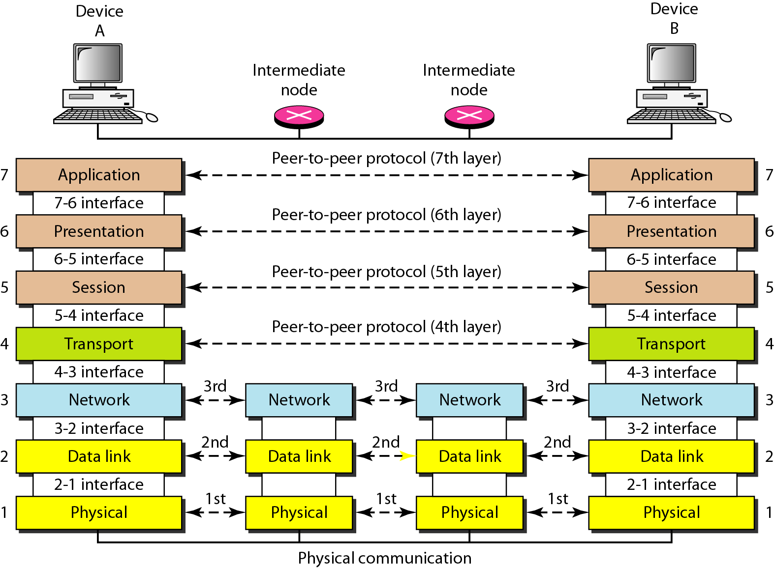
The interaction between layers in the OSI model

Slide 62
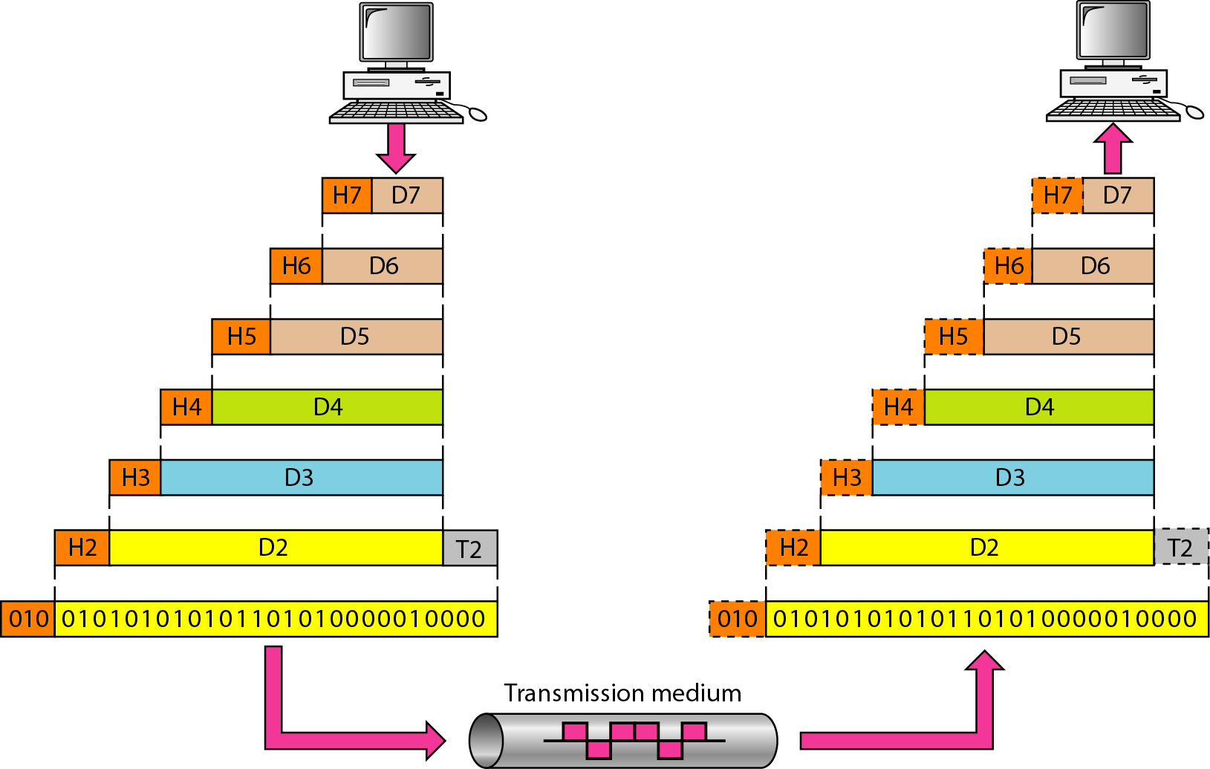
An exchange using the OSI model

Slide 63
LAYERS IN THE OSI MODEL
Physical layer:
Defining the Characteristics of the interface between the devices and the transmission medium.
Representations of the bits : Sequences of 1’s and 0’s and encoding these bits into signals.
Data rate : No. of bits sent per second
Synchronization of bits : Receiver and senders clock synchronization.
Line Configuration :Connection of the devices to the media.
Point to point
Multi point
Physical Topology : Defines the structure of a network.
Transmission mode: Simplex , half-duplex , full-duplex

Slide 64
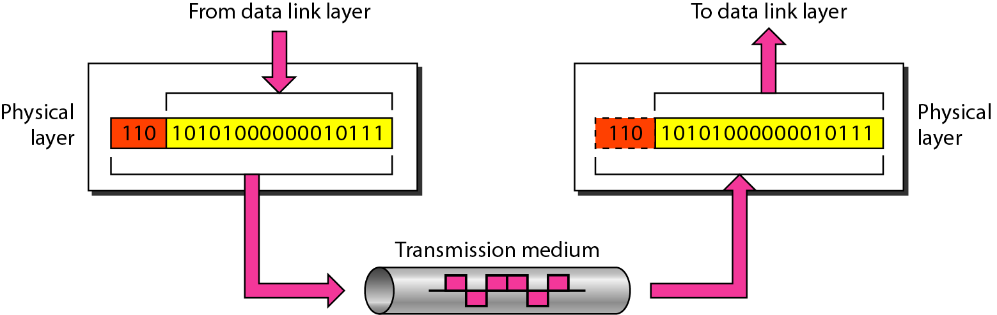
Physical layer

Slide 65

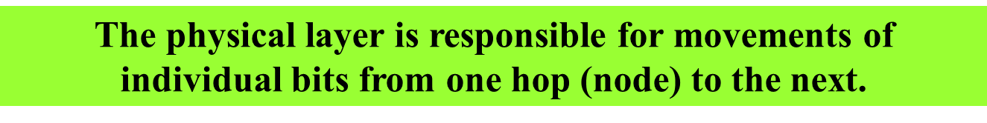

Slide 66
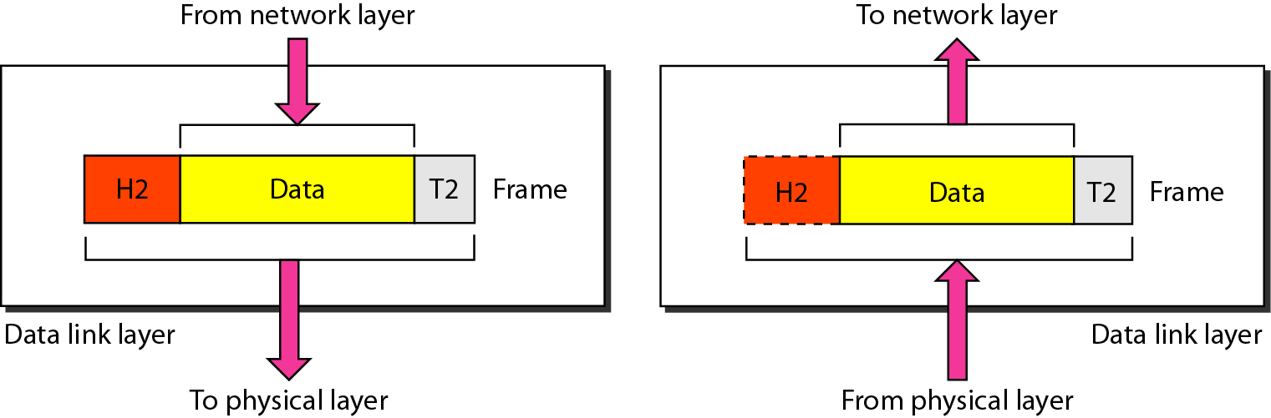
2. Data link layer

Slide 67
Data link layer functionalities
Responsible for hop to hop delivery
Framing : Division of stream of bits into manageable data.
Physical Addressing : Adding sender and receiver addressing information to the frame
Flow Control : Controlling the flow of data to avoid bottleneck.
Error Control : Avoiding the loss of data
Access Control : Determining which device has the control over the transmission line.

Slide 68


Slide 69
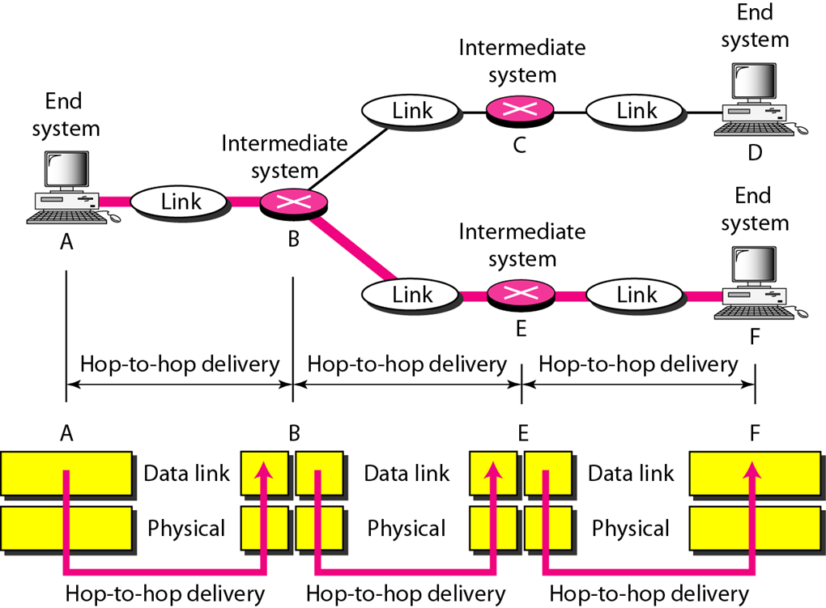
Hop-to-hop delivery

Slide 70
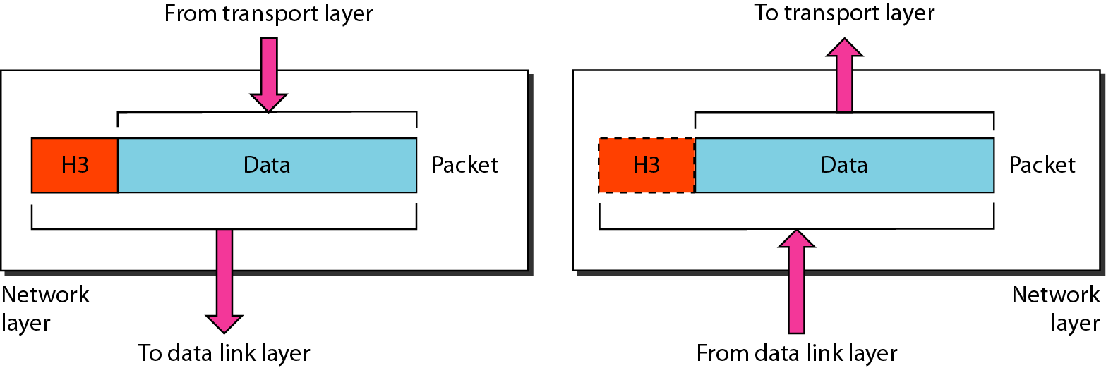
Network layer

Slide 71
Network layer functionalities
Responsible for source to destination delivery of packet across multiple networks.
Logical Addressing : Adding sender and receiver addressing information to the Packet.
Routing : Forwarding the packets to one of the networks. Router or switches are responsible for forwarding these packets.

Slide 72

Note
The network layer is responsible for the delivery of individual packets from
the source host to the destination host.

Slide 73
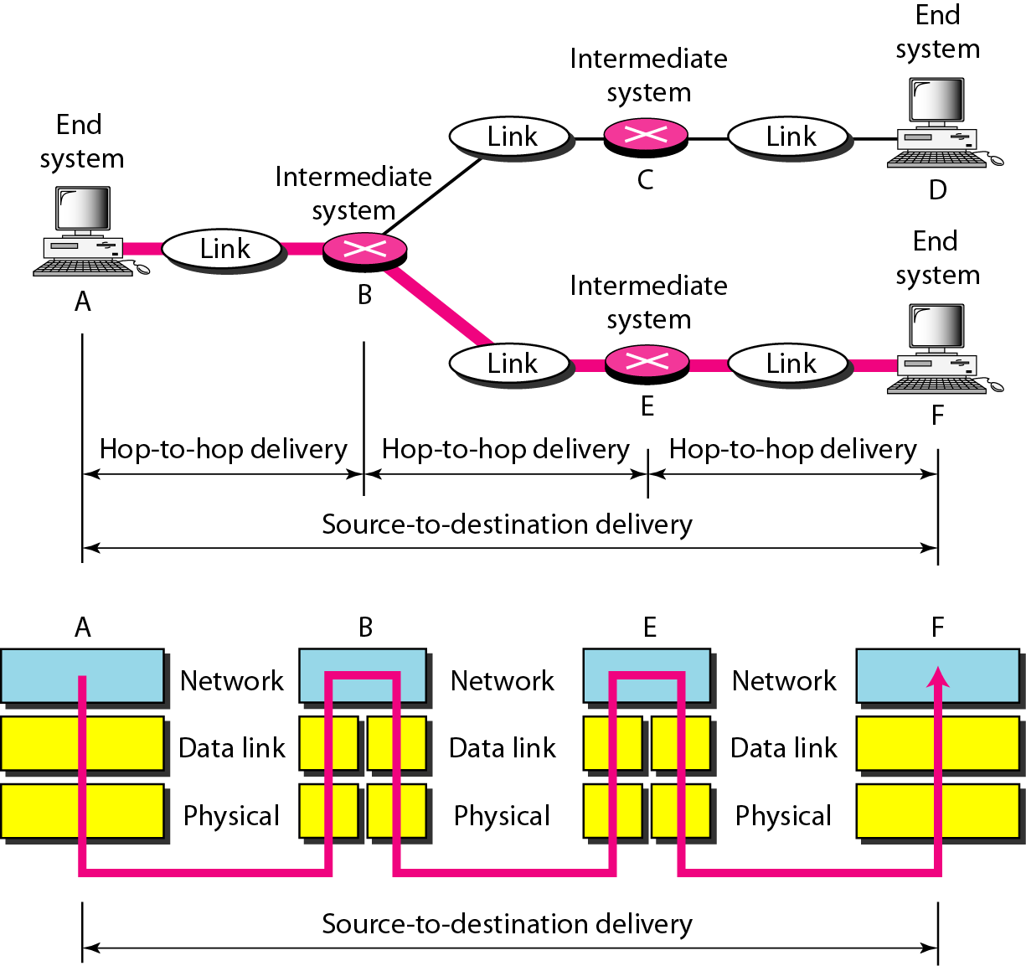
Source-to-destination delivery

Slide 74
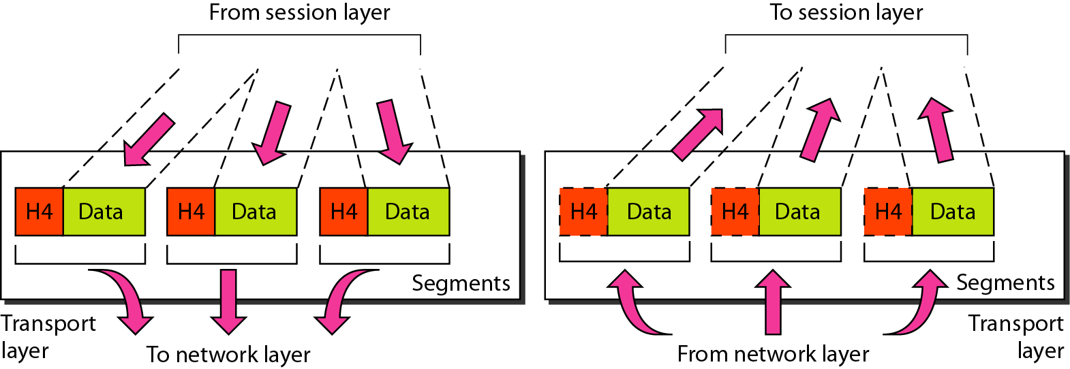
Transport layer

Slide 75
Transport layer functionalities
Responsible for process to process delivery
Service Point Addressing : Specifying port address of receiver process.
Segmentation and Reassembly : Dividing a message into transmittable segments, with each segments containing a sequence number.
Connection Control :
Connection Oriented.
Connection less.
Flow Control : Here it is performed end to end process
Error Control : Avoiding data loss.

Slide 76
Note
The transport layer is responsible for the delivery of a message from one process to another.

Slide 77
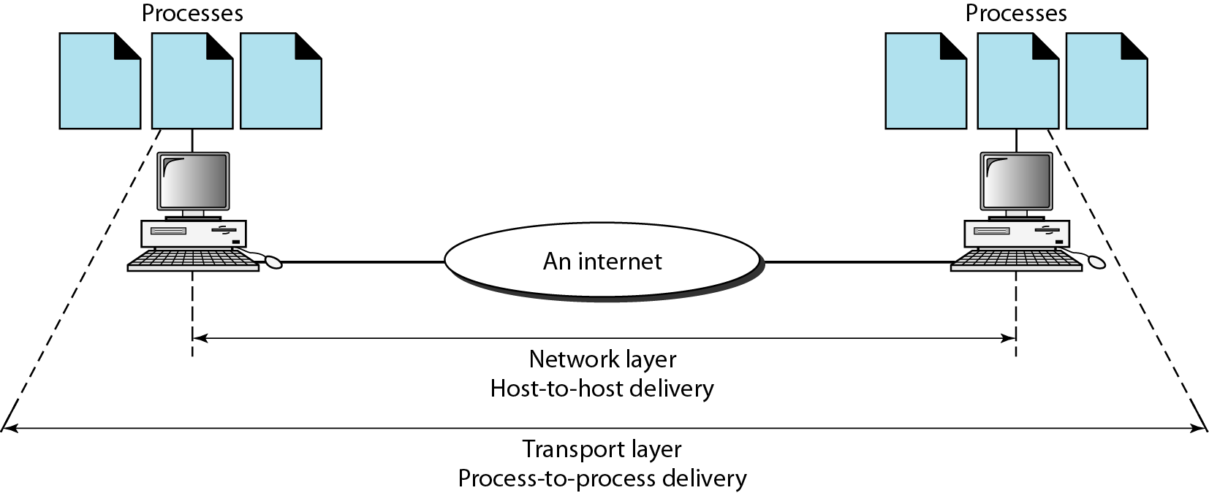
Reliable process-to-process delivery of a message

Slide 78
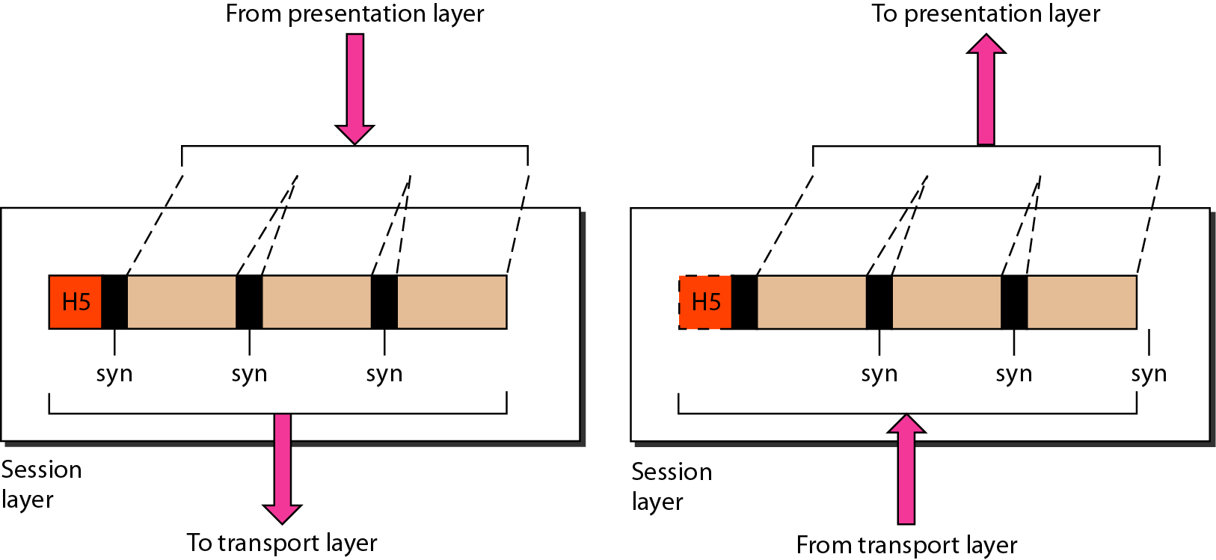
Session layer

Slide 79
Session layer functionalities
It establishes, maintaining and synchronizes the interaction among communicating systems. It is called dialog controller
Dialog Control : Allowing two systems to process to communicate in half duplex or full – duplex mode.
Synchronization : Adding the check points to the data.

Slide 80
Note
The session layer is responsible for dialog control and synchronization.

Slide 81
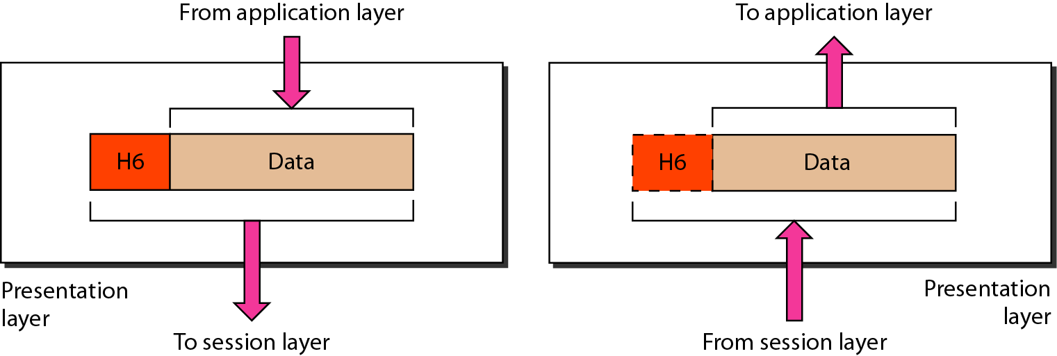
Presentation layer

Slide 82
Presentation layer functionalities
Translation : Changing information of the sender into its receiver – dependent format.
Encryption : Sending original information in another form for security of the information.
Compression: Reducing the data for transmission to use the line (physical media) efficiently.

Slide 83
Note
The presentation layer is responsible for translation, compression, and encryption.

Slide 84
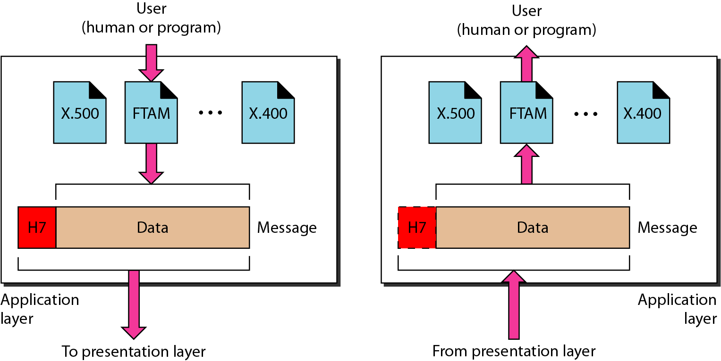
Application layer

Slide 85
Application layer functionalities
It provides user interfaces and support for services such as electronic mail , remote file access and transfer.
Network Virtual Terminal : Emulation of software version of physical terminal
File Transfer, access and management : Allowing user to access remote computer to retrial file and use in local computer .
Mail Services : Email forwarding and storage.
Directory Services : Provides Distributed Data base sources and access for global information about various objects and services.

Slide 86
Note
The application layer is responsible for providing services to the user.

Slide 87
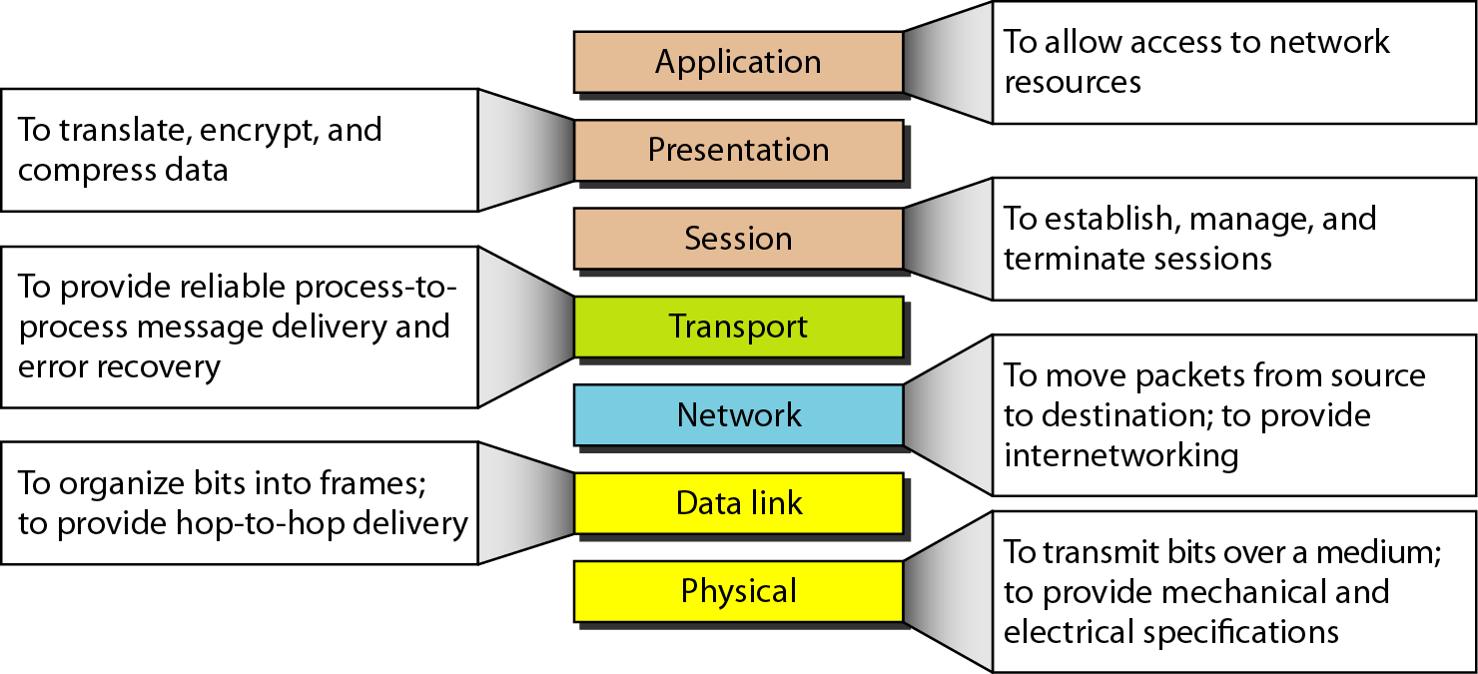
Summary of layers

Slide 88
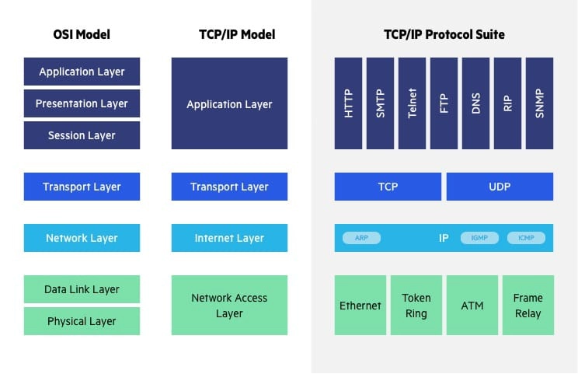
OSI versus TCP/IP

Slide 89
OSI versus TCP/IP
When we compare the two models, we find that two layers, session and presentation are missing from the TCP/IP protocol suite.
These two layers were not added to the TCP/IP protocol suite after the publication of the OSI model.
The application layer in the suite is usually considered to be the combination of three layers in the OSI model.

Slide 90
OSI versus TCP/IP
Two reasons were mentioned for this decision.
First, TCP/IP has more than one transport-layer protocol.
Some of the functionalities of the session layer are available in some of the transport-layer protocols.
Second, the application layer is not only one piece of software. Many applications can be developed at this layer.
If some of the functionalities mentioned in the session and presentation layers are needed for a particular application, they can be included in the development of that piece of software.

Slide 91
TCP/IP PROTOCOL SUITE
It is also called Internet Protocol Suite as it consists of set of communication protocols used for the Internet and other similar networks.
Two most important Protocols : TCP & IP.
The layers in the TCP/IP protocol suite do not exactly match those in the OSI model.
The original TCP/IP protocol suite was defined as having four layers:
1. host-to-network layer → (physical + data link layer) of OSI
2. Internet → Network Layer of OSI
3. Transport → Transport layer of OSI.
4. application→ (Session + Presentation + application) of OSI model.

Slide 92
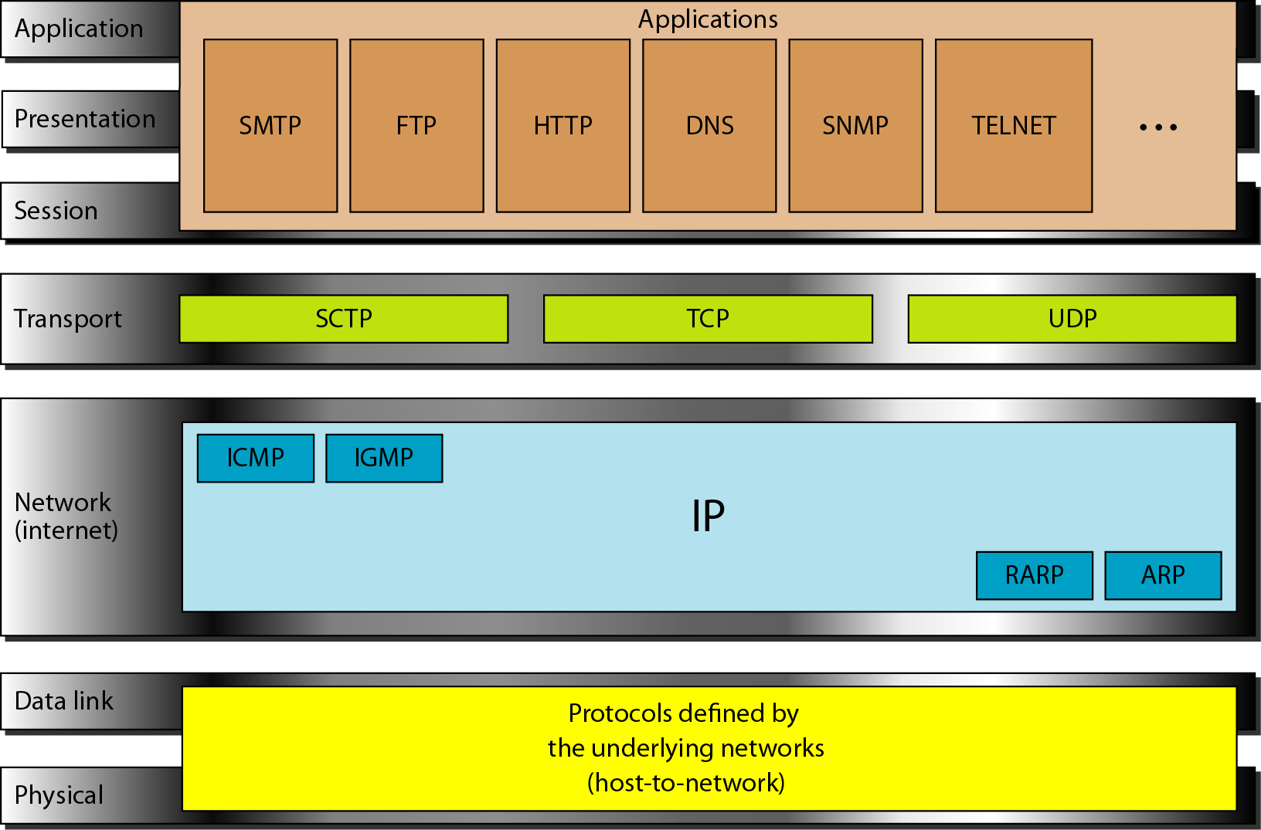
TCP/IP suite

Slide 93
TCP/IP Layers
Physical and Data Link Layers :
It supports all the standard and proprietary data base
Network Layers :
Internet Protocol (IP) : Used to send datagram (packets) from the source host to the destination host solely based on its address.
Unreliable and connection less
Best effort service
IP data is called datagrams
Address Resolution Protocol (ARP) : Used to find physical address when its internet address is known.
Reverse Address Resolution Protocol (RARP): Used to find internet address when its physical address is known.
Internet Control Message Protocol (ICMP) : Used to send query and error reporting messages.
Internet Group Message Protocol (IGMP) : Simultaneous transmission to a group of recipients.

Slide 94
TCP/IP Layers
Transport Layers :
User Datagram Protocol : Used to send short messages sometimes known as datagram.
Process to Process protocol that adds only port address , checksum, error control and length information to the data.
UDP does not guarantee reliability or ordering
Transmission Control Protocol : Connection oriented and reliable
Data is called segments
reordering of the segments
Stream Control Protocol : Newer application support, such as voice over network.
Application Layer : Equivalent to combined session , presentation and application layers of the OSI model.

Slide 95
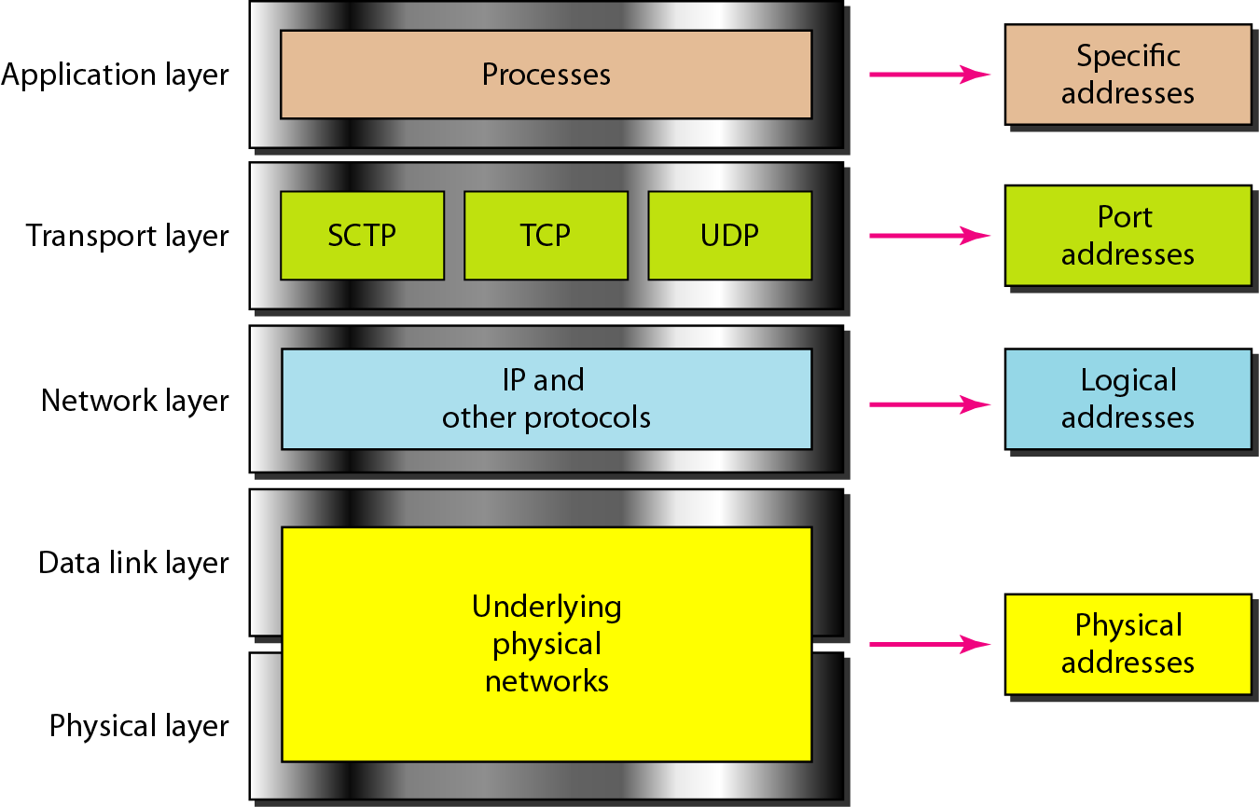
Relationship of layers and addresses in TCP/IP

Slide 96
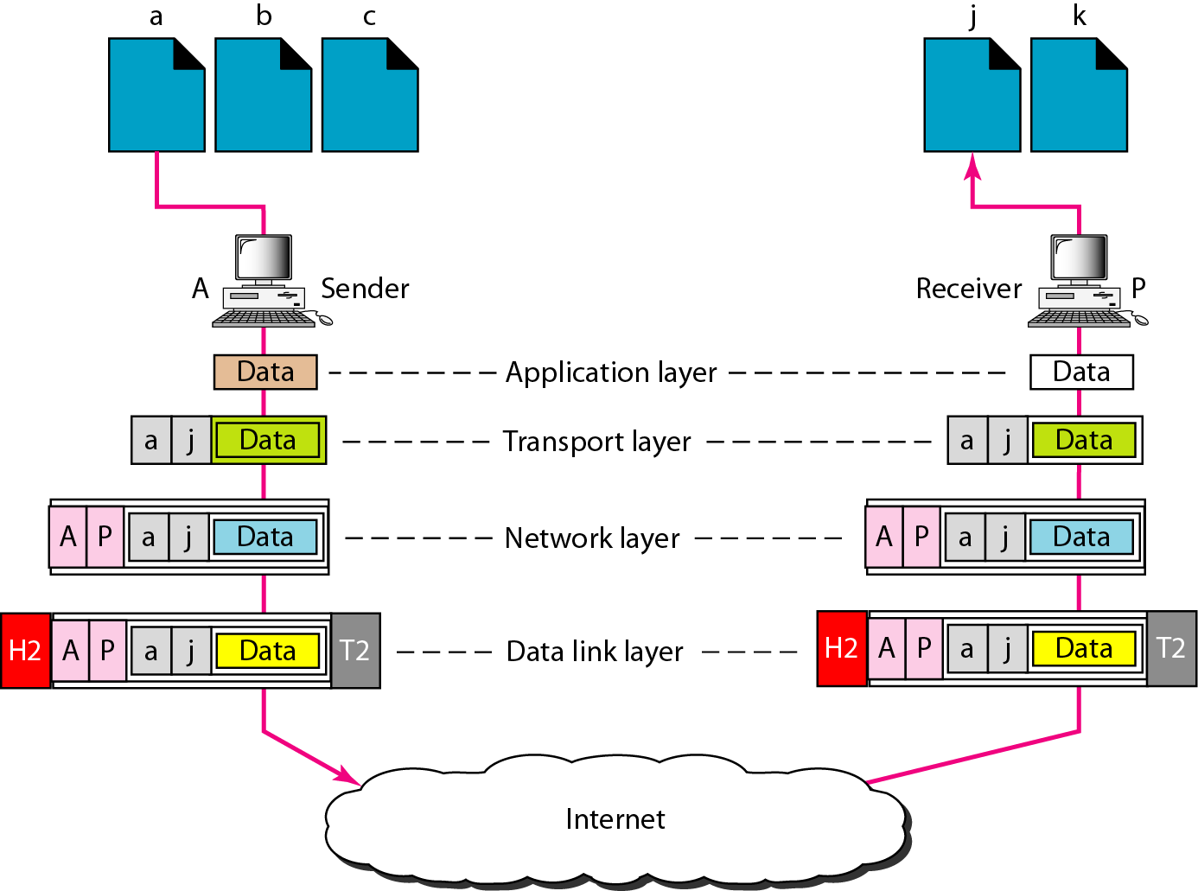
Port addresses

